Slide 1
Adding Physical State to ChemInventory

Slide 2
Adding a New Container to your Inventory

Slide 3
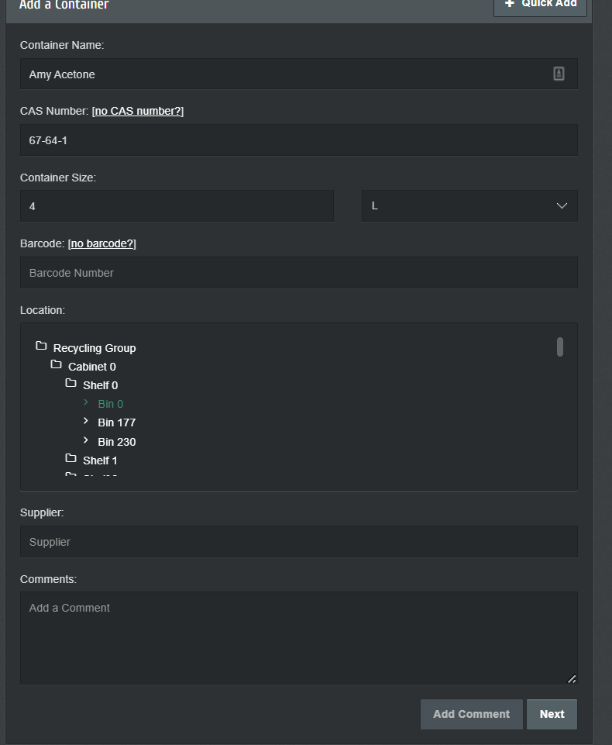
Adding a New Container
Add chemical information and click “Next”

Slide 4
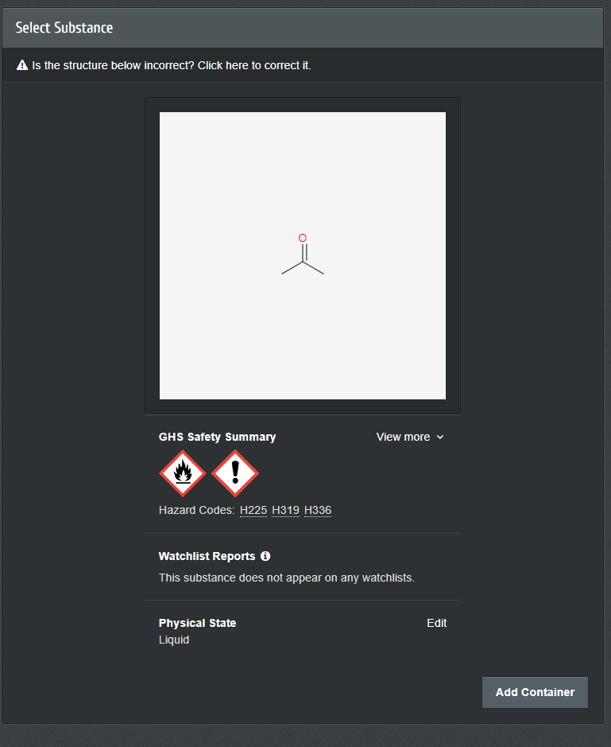
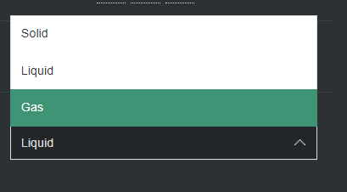
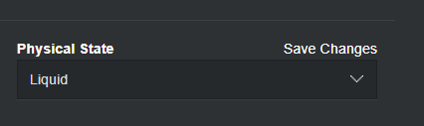
Adding Physical State
1. Click on “Edit” and a drop down will appear.
2. Click on the proper Physical state of the matter
3. Save your changes

Slide 5
Editing a Container in your Inventory

Slide 6
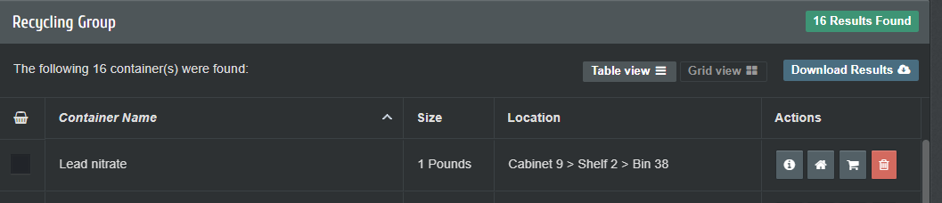
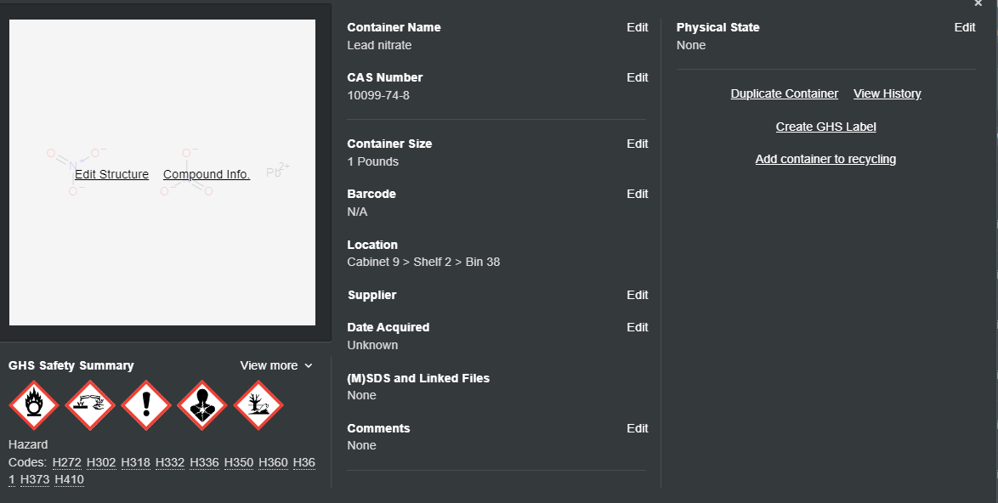
Editing a container
Click on Chemical Name
Edit State and Save changes.

